Slide 1

Programming Web Server
CSCI 434: Network Systems and Design

Slide 2
Materials Description
Primary Materials
“ProjectDescription.pptx”: This presentation provides an overview of the project, including the requirements, solution guidance, and grading criteria.
“Q&A_FromStudents.doc”: This document contains frequently asked questions and their answers, offering valuable insights while working on this project.
Programming-Related Materials
“evaluationWeb/”: This directory contains all necessary contents for hosting your server.
Reference Materials
For additional clarification, refer to the following materials:
“ProjectAssignment.htm”: Offers more comprehensive information about the project requirements.
“SolutionGuide.docx”: Provides further details on solution approaches and grading guidance.
“videos/”: Includes videos demonstrating how to carry out evaluations for tasks 5 and 6.

Slide 3
Outline
1 Project: Web Server
2 Requirements
3 Solution Guidance
4 Grading Guidance

Slide 4


1 Project: Web Server
You will design and implement a simple HTTP/1.1 compliant web server.
Your web server should be fully compatible with standard web browsers.
Client
Client Request
Server
GET /lens_files/filelist.xml HTTP/1.1
Host: xxx
User-Agent: xxx
Accept: xxx
Server Response
HTTP/1.1 200 OK
Date: Mon Feb 19 11:23:53 EST 2024
Server: Demo's Server
Last-Modified: Tue Mar 07 19:00:26 EST 2023
Content-Length: 1104

Slide 5
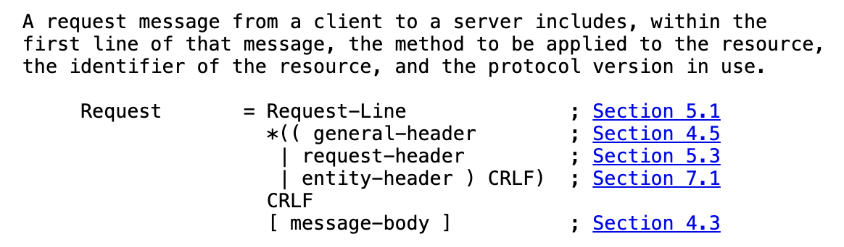
2 Requirements – Web Server Actions
A functional web server must perform the following general actions:
Receive a request from a socket
Parse the request to find out what the sender wants
Find the desired data
Respond to the sender with the appropriate information via a socket
Definition of HTTP Request
(Source: https://www.rfc-editor.org/rfc/rfc2616#section-5)

Slide 6
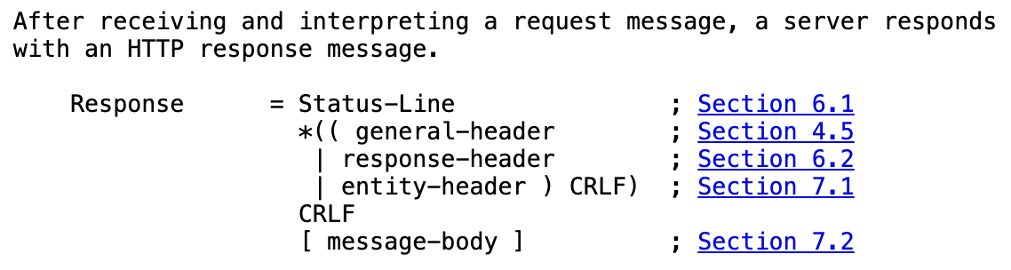
2 Requirements – Supported Commands
Your web server will only support the commands GET and HEAD.
GET implies the sender wants a file from the webserver, and therefore your webserver must return the response header and the desired file
HEAD implies the sender just wants the header for a file from the webserver, and therefore your webserver will only return the response header of that file
Any other commands received will be responded to as a "501: Not Implemented" error
Definition of HTTP Response
(Source: https://www.rfc-editor.org/rfc/rfc2616#section-6)

Slide 7
2 Requirements – Specific Requirements
Your program shall run in the default Java package (no package line). The main method will be in the MyWebServer.java file.
Your program shall take two command line arguments. The first will indicate the port number to use, and the second will serve as the root path for all filenames.
Your server shall support absoluteURI requests
Your server should fetch index.html when the URL is a directory.
Your server must support the If-modified-since header
The java.net.URL class may be used to parse the URL, but you may not use it to fetch objects.
More Details could be found at ProjectAssignment.htm

Slide 8
2 Requirements – Submission Guidelines
You should submit this MyWebServer.java file on Blackboard.
The TA will use evaluationWeb provided in the assignment to test your web server.
Unless you have a masochistic side, you shouldn't be aiming to achieve a fully-compliant HTTP/1.1 server.
If your web server supports HEAD and GET with persistent connections and If-modified-since from Chrome, you have probably implemented everything we expect.

Slide 9
3 Solution Guidance – Tools
Using an IDE (Integrated Development Environment) and a VCS (Version Control System) is useful for this project.
Visual Studio Code/IntelliJ IDEA and GitHub are recommended. You could use Java language level 17 (LTS) for this project.
Visual Studio Code: https://code.visualstudio.com/
You can install Java on Plugins - Extension Pack for Java.
IntelliJ IDEA: https://www.jetbrains.com/idea/
You can specify Java Language Level in File -> Project Structure -> Language Level.

Slide 10
3 Solution Guidance – Server Program
Ensure that the server program can be run according to the assignment specifications (the first argument is port number, the second one is the address of the evaluationWeb provided in the assignment).
java MyWebServer.java <<port_number>> ~/evaluationWeb
// Class representing the web server
public class MyWebServer {
// Entry point of the program
public static void main(String[] args) throws IOException {
xxx
}
}

Slide 11
3 Solution Guidance – Request Parser
Implement the section of the program that will receive the entire request from the socket and parse the information that you need to fulfill the GET or HEAD request. This section could be a request parser.
An HTTPRequest object is created with a request string and a root path, extracting key information such as Command, Path, and If-Modified-Since date.
The path is processed by truncating if necessary, concatenating to the root directory, and appending "index.html" if it leads to a directory.
The information enables action based on the request, moving to address the corresponding objective.
Error handling includes changing the error code to 400 Bad Request for missing command/path or unparseable If-Modified-Since, and to 501 Not Implemented for unsupported commands.

Slide 12
3 Solution Guidance – Request Handler
Implement the part of the server that takes some action based upon the information within the particular HTTP request object. This could be thought of as a request handler.
The request handler processes the request object to locate the specified file.
An HTTP response object is created, with header parameters like "Status-Line", "Date", "Server", "Last-Modified", and "Content-Length" filled, preparing the header of the HTTP response.
For HEAD requests, the response, containing only the header fields, is sent back through the DataOutputStream.
For GET requests, the file content is also sent back through the DataOutputStream, in addition to the header fields.
More Details could be found at SolutionGuide.docx

Slide 13
4 Grading Guidance – Task 1 (5 points )
Does your java code run?
I will download your Java code and will use the following java command to run your webserver
java MyWebServer.java <<port_number>> ~/evaluationWeb
You get these 5 points if your code runs without additional troubleshooting.

Slide 14
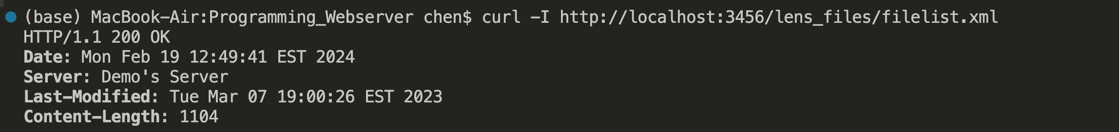
4 Grading Guidance – Task 2 (25 points )
Can your webserver receive a HEAD request?
I will use a basic terminal shell and execute the following CURL command to test HEAD:
curl -I http://localhost:<<port_number>>/lens_files/filelist.xml
You get full points if your head request returns all headers specified in instructions (Status, Date, Server, Last-Modified, Content-Length). 5 points for each of the 5 fields.

Slide 15
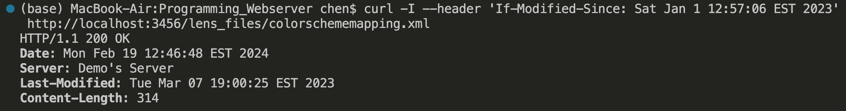
4 Grading Guidance – Task 3 (10 points )
Does your server support the optional “If-Modified-Since” header?
To test “If-Modified-Since” header:
curl -I --header 'If-Modified-Since: Sat Jan 1 12:57:06 EST 2023' http://localhost:<<port_number>>/lens_files/colorschememapping.xml
I will change the date to a future date (yellow highlight) to experiment whether your server can make the appropriate response and not return a file.
curl -I --header 'If-Modified-Since: Sat Dec 28 12:57:06 EST 2024' http://localhost:<<port_number>>/lens_files/colorschememapping.xml
You get 10 points if you return the appropriate error code 304.

Slide 16
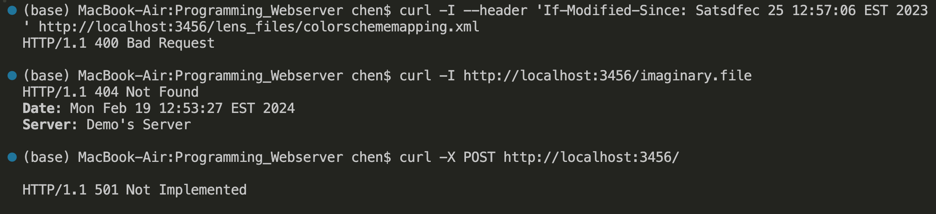
4 Grading Guidance – Task 4 (5 points )
Does your server return 400 (bad request), 404 (file not found), 501 (not implemented) errors?
I will attempt a 400 bad request (e.g. a malformed date, shown in yellow)
curl -I --header 'If-Modified-Since: Satsdfec 25 12:57:06 EST 2023' http://localhost:<<port_number>>/lens_files/colorschememapping.xml
I will attempt a 404 file not found request
curl -I http://localhost:<<port_number>>/imaginary.file
I will attempt a 501 not implemented request
curl -X POST http://localhost:<<port_number>>/
You get full points long as the errors are visible in the returned content body (not only in the header) in some way.

Slide 17
4 Grading Guidance – Task 5 (15 points)
Can your webserver make the correct response over Google Chrome?
I will test that your webserver can load a sample website from Dr. Zhou. (LENS laboratory website).
I will use the following link and enter it into the browser: http://localhost:<<port_number>>/
This should load the index.html file. I will click on the “LENS LAB” button to load the lens.html file.
If your server loads both webpages without any errors/ missing images (.jpg, .gif, .png)/ missing text/ fonts/ colors/ etc., you will get full credit will not have to complete the following task 6 and automatically get the full 50 (15+35) points.
Demo Video available in videos/Test 5 Website Grading Tutorial.mp4

Slide 18
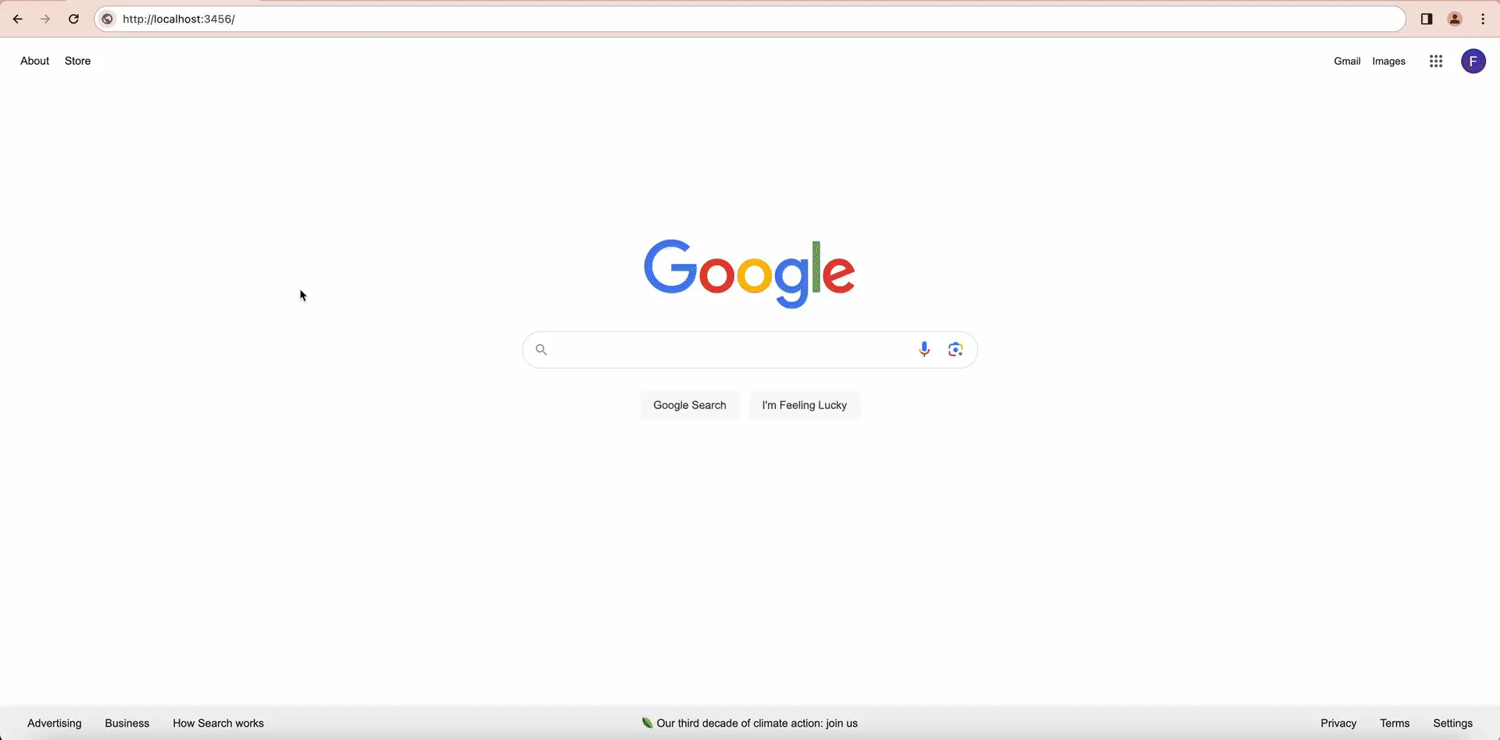
4 Grading Guidance – Task 5 (15 points)

Slide 19
4 Grading Guidance – Task 6 (35 points)
Which files can you load successfully? (35 points)
If your server fails to load the sample website with all its images and files, I will test individual image types (.gif / .jpg / .png ), and a variety of text-based files (.txt / .html / .xml/ .css). I will use the following URL prompts:
http://localhost:<<port_number>>/examples/penguin.jpg
http://localhost:<<port_number>>/examples/apple_pie.png
http://localhost:<<port_number>>/examples/exampleGET.gif
http://localhost:<<port_number>>/examples/text.txt
http://localhost:<<port_number>>/examples/filelist.xml
http://localhost:<<port_number>>/examples/mm_health_nutr.css
http://localhost:<<port_number>>/examples/bbc/
You get 5 points per success
Demo Video available in videos/Test 6 Files Grading Tutorial.mp4

Slide 20
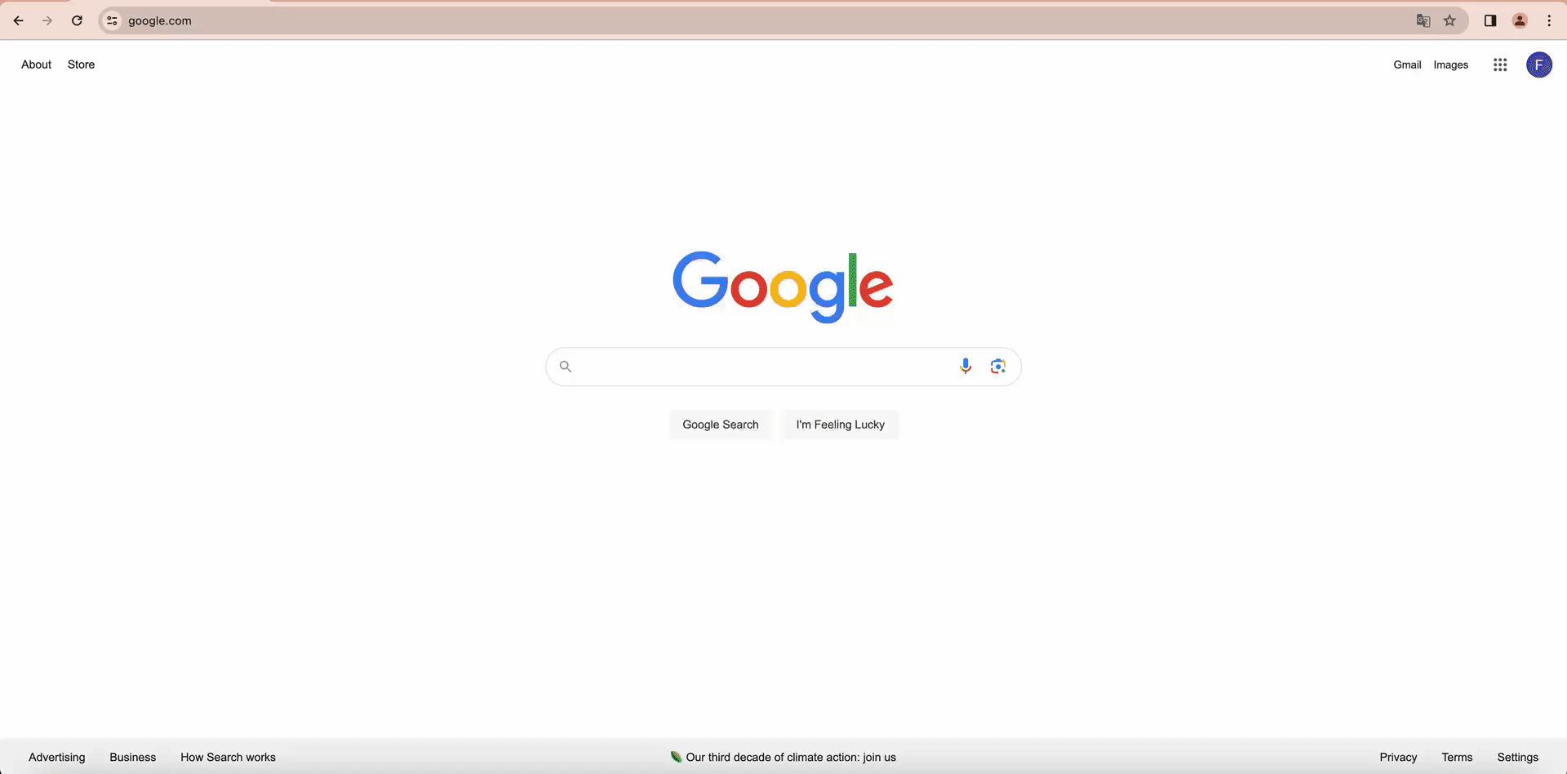
4 Grading Guidance – Task 6 (35 points)

Slide 21
4 Grading Guidance – Task 7 (5 points)
Is there documentation?
These points will be awarded for comments in code, descriptive naming of functions & variables, an organized code-base and other good practices to make it easy to analyze your code.
// Class representing the web server
public class MyWebServer {
// Server name for response headers
private static final String SERVER_NAME = xxx
// Entry point of the program
public static void main(String[] args) throws IOException {
// Parse command-line arguments for port and root directory
int port = xxx;
String rootPath = xxx;
}
}

Slide 22
4 Grading Guidance – Summary
5% - Code runs
25% - HEAD request and fields
10% - “If-Modified-Since”
5% - Misc errors (400 / 404 / 501)
15% - Web browser test
35% - File test
5% - Documentation

